Slide 1



Adventure Works - Evaluación2
View in Power BI
Last data refresh:
09/12/2021 21:38:22 UTC
Downloaded at:
24/07/2022 7:33:43 UTC

Slide 2
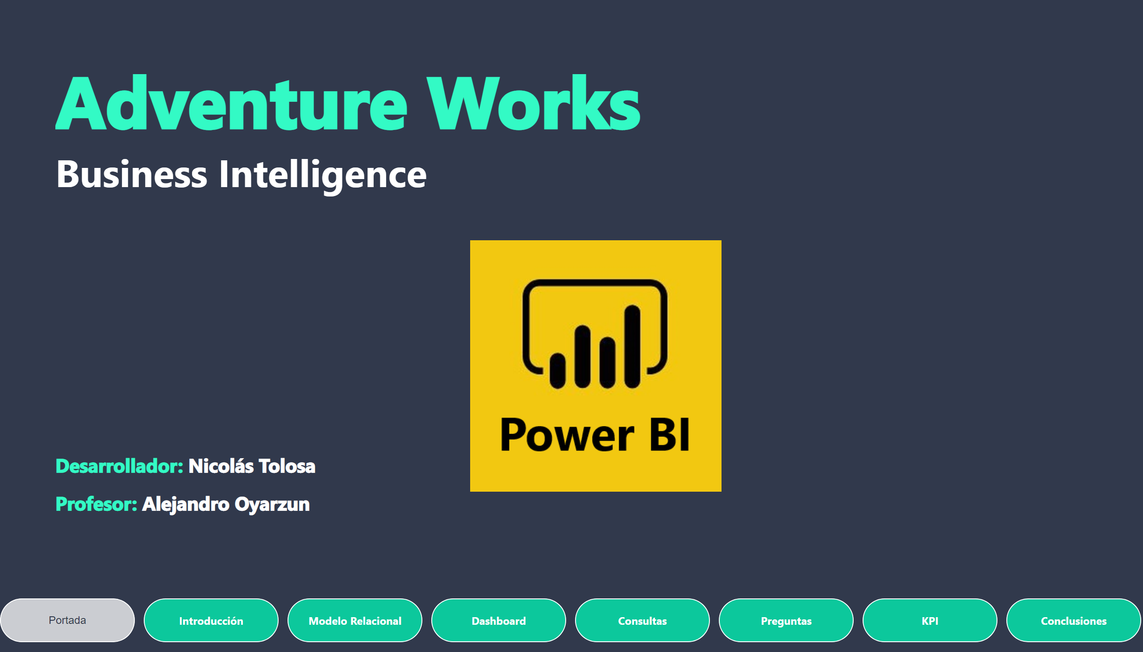
Portada
Notes:
textbox
No alt text provided
textbox
No alt text provided
image
No alt text provided
pageNavigator
No alt text provided

Slide 3
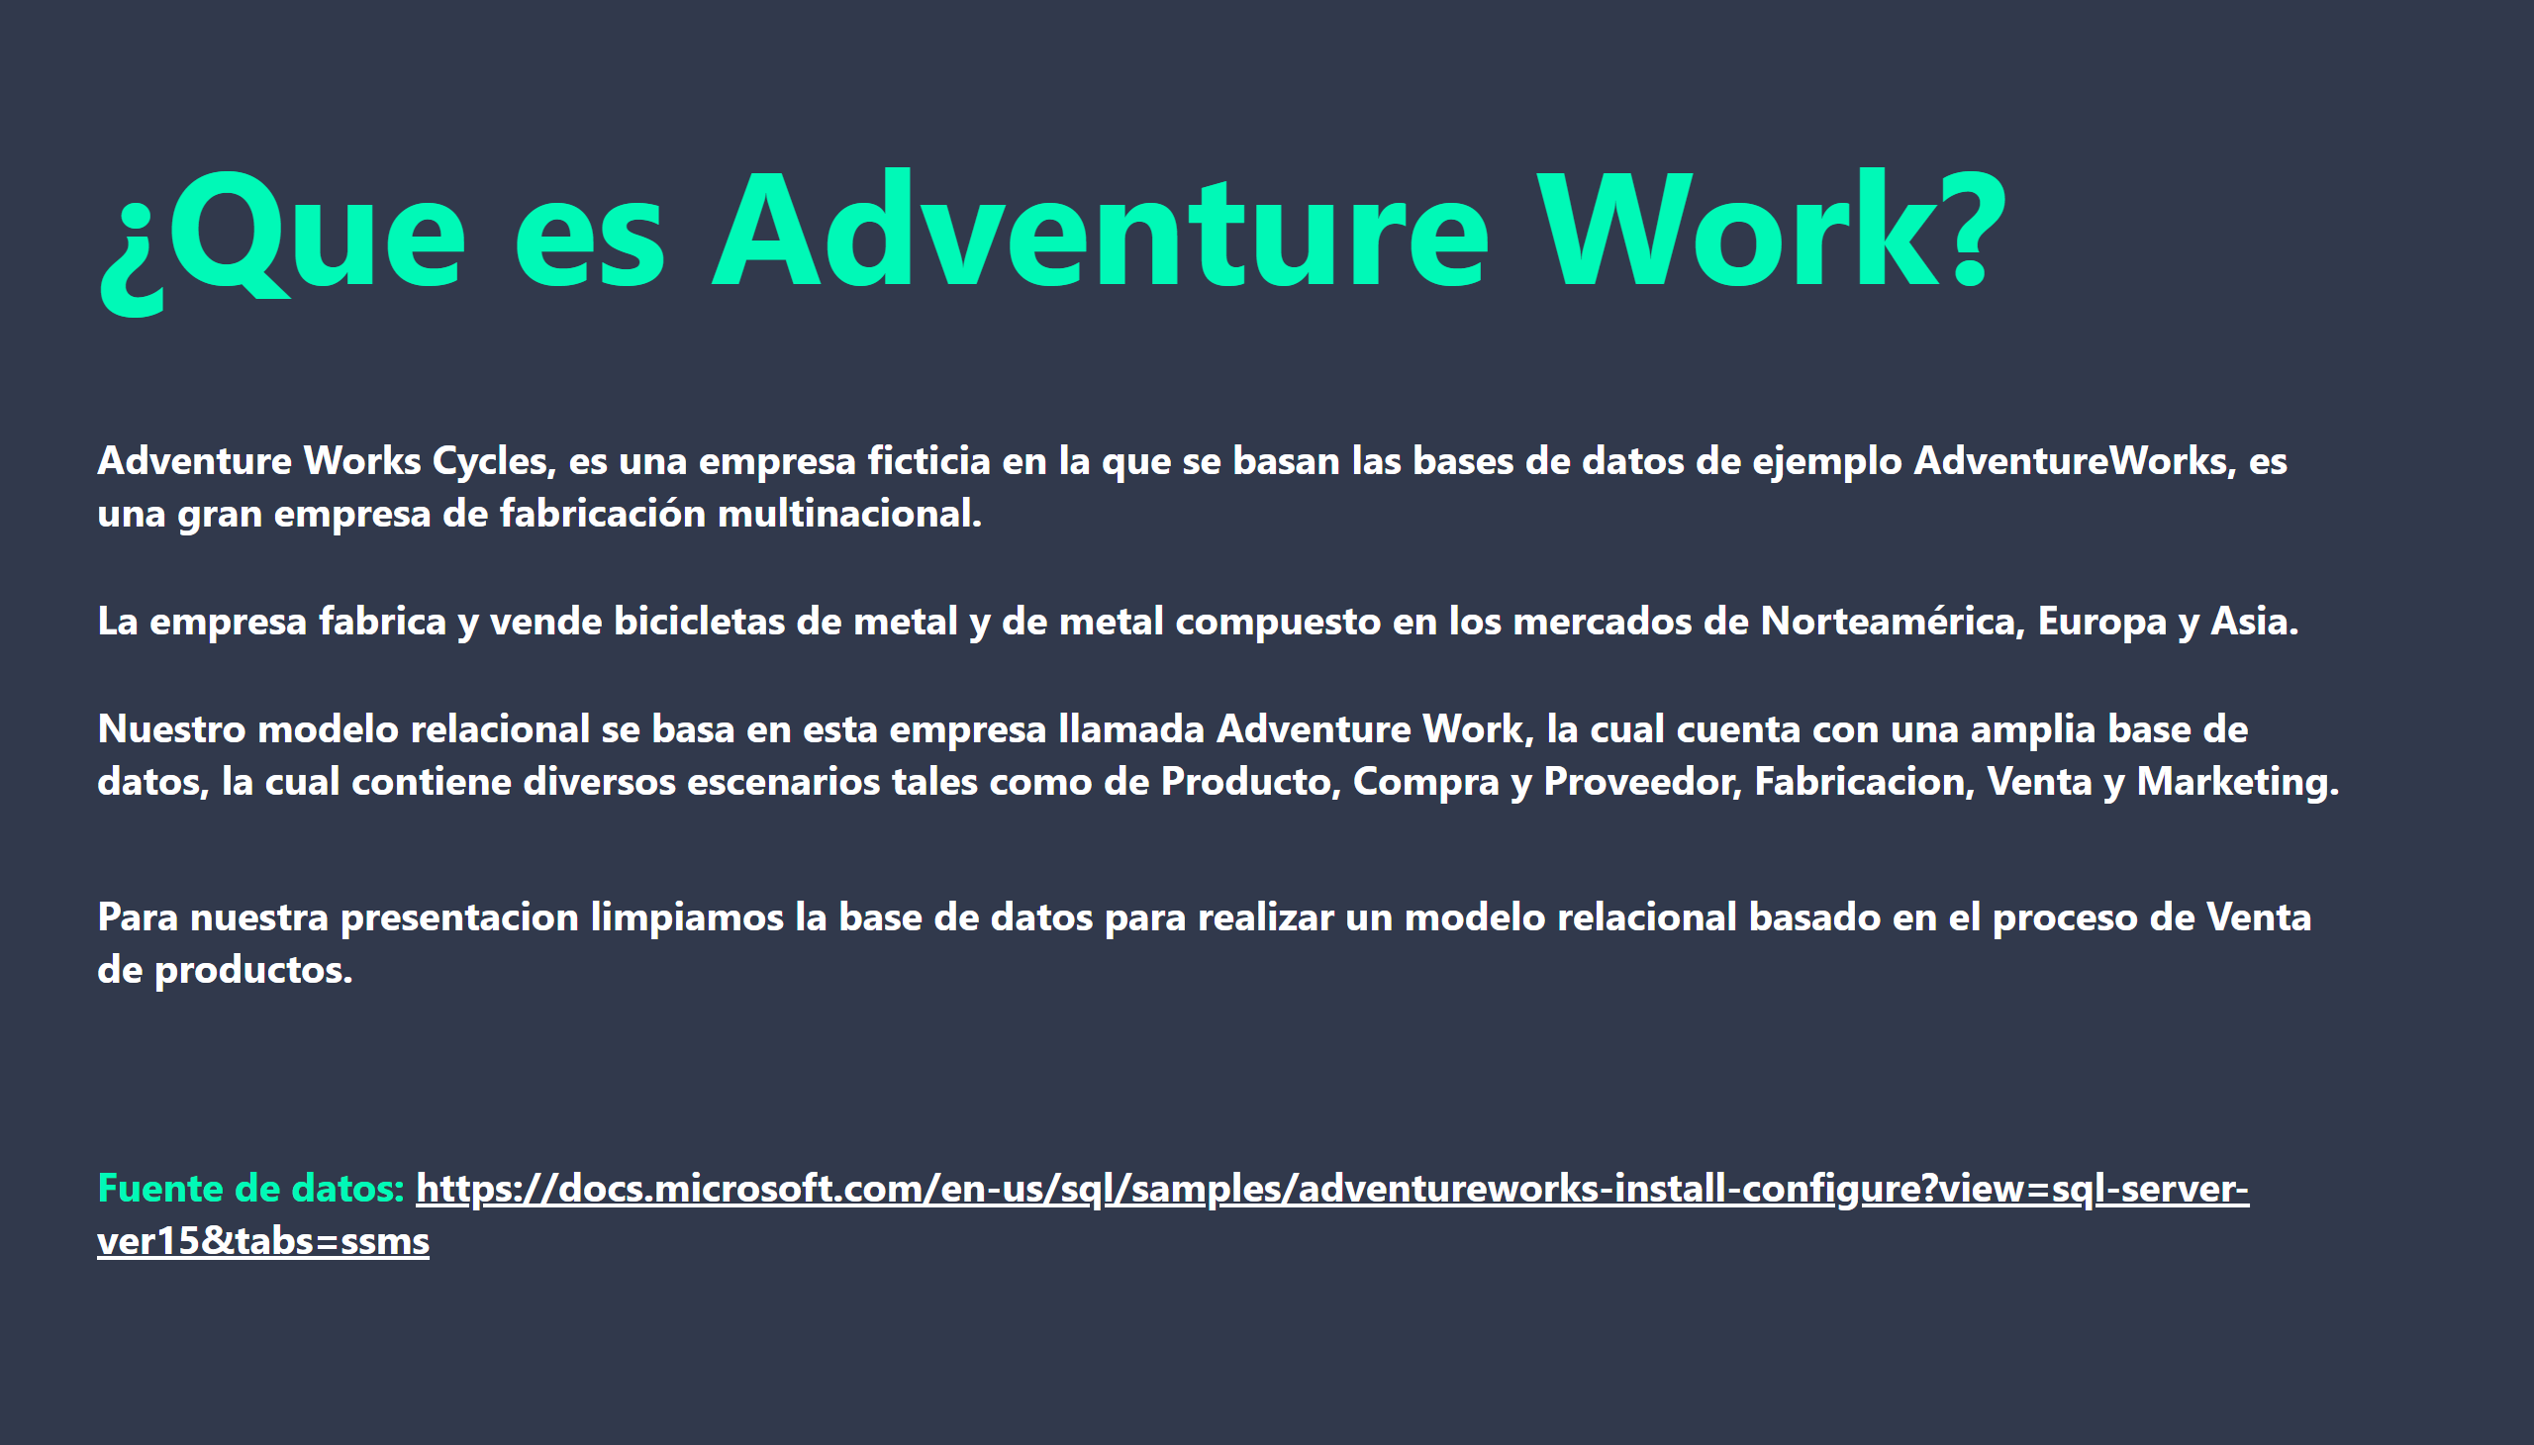
Introducción
Notes:
textbox
No alt text provided
textbox
No alt text provided

Slide 4
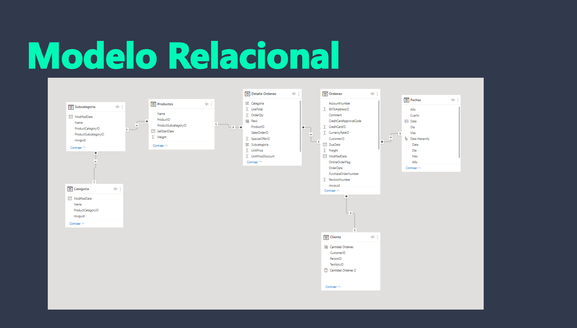
Modelo Relacional
Notes:
image
No alt text provided
textbox
No alt text provided

Slide 5
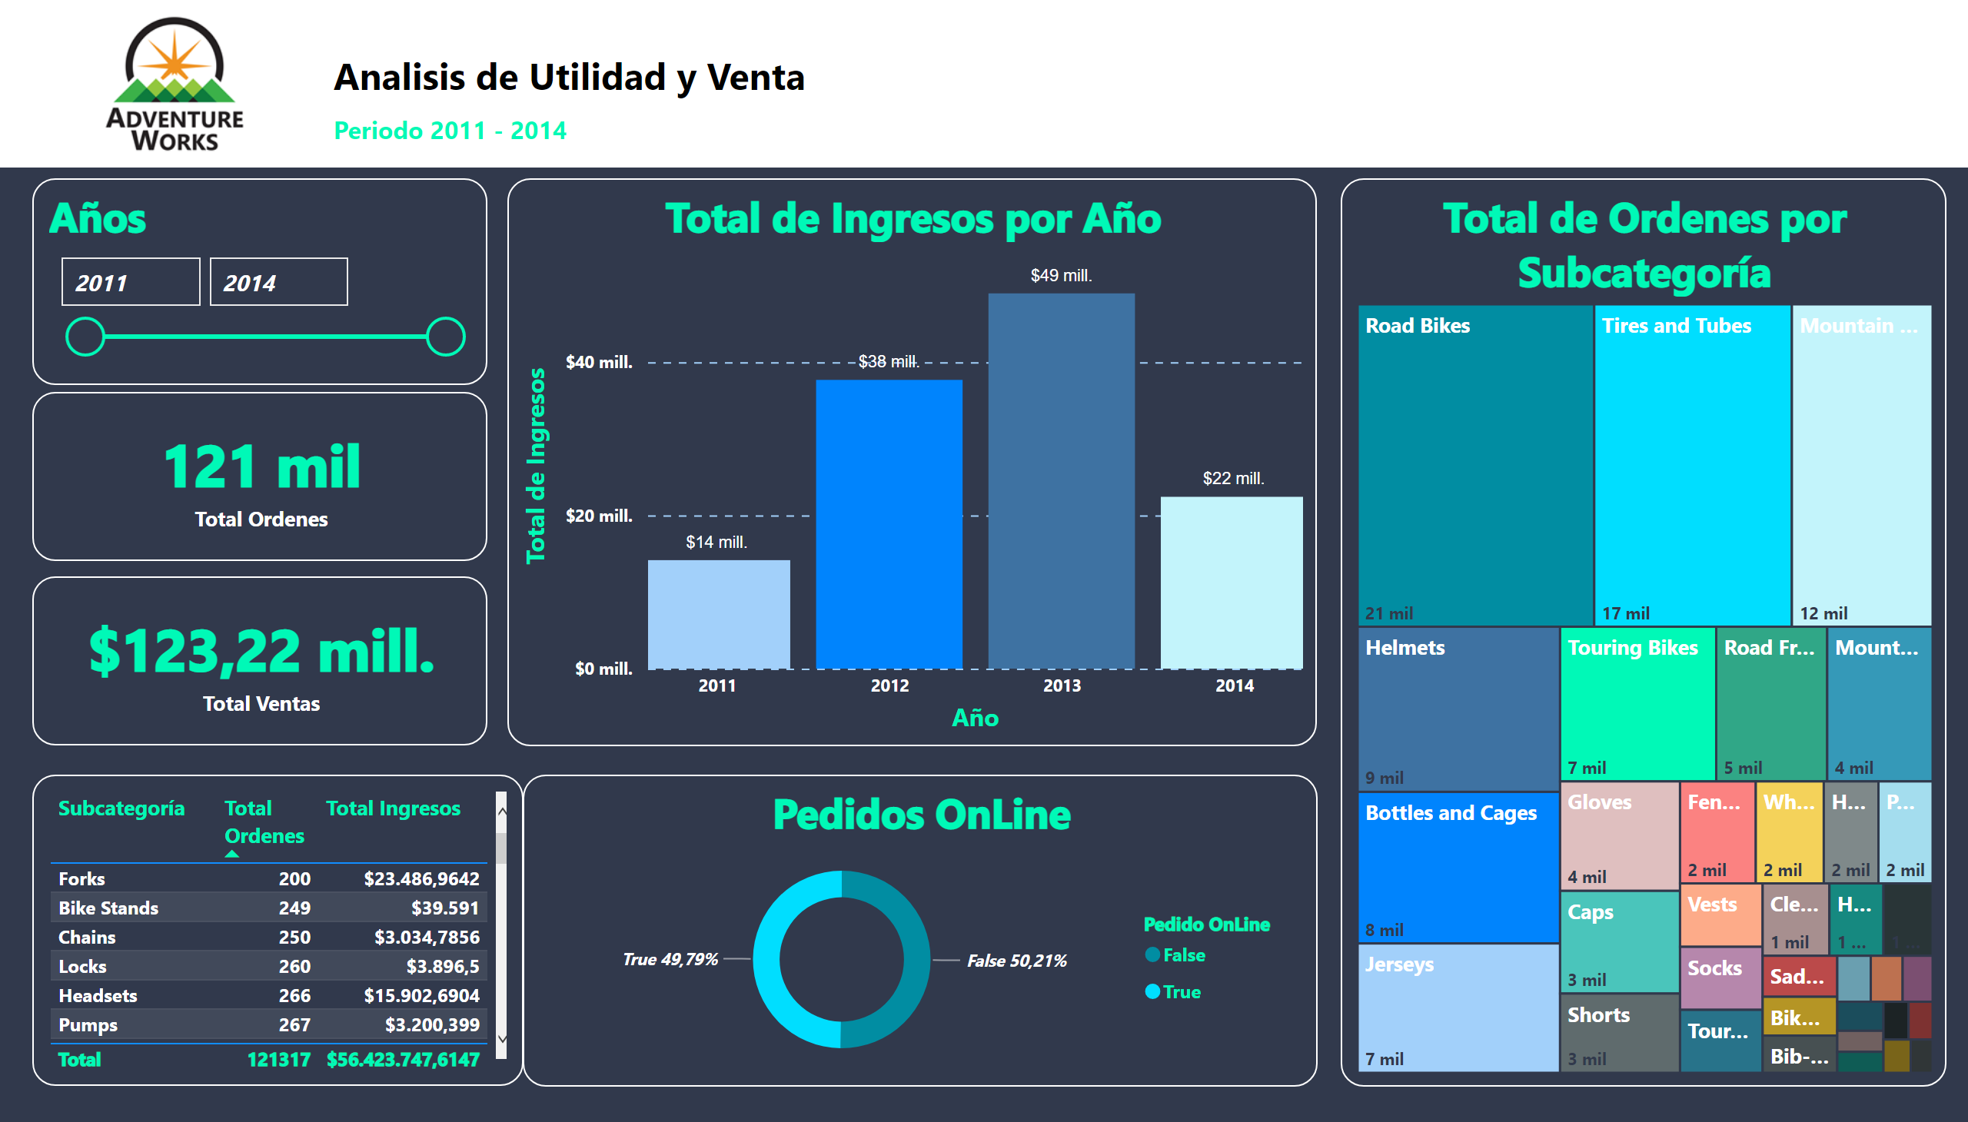
Dashboard
Notes:
card
No alt text provided
Total de Ordenes por Subcategoría
No alt text provided
Total de Ingresos por Año
No alt text provided
Años
No alt text provided
card
No alt text provided
image
No alt text provided
textbox
No alt text provided
tableEx
No alt text provided
Pedidos OnLine
No alt text provided

Slide 6
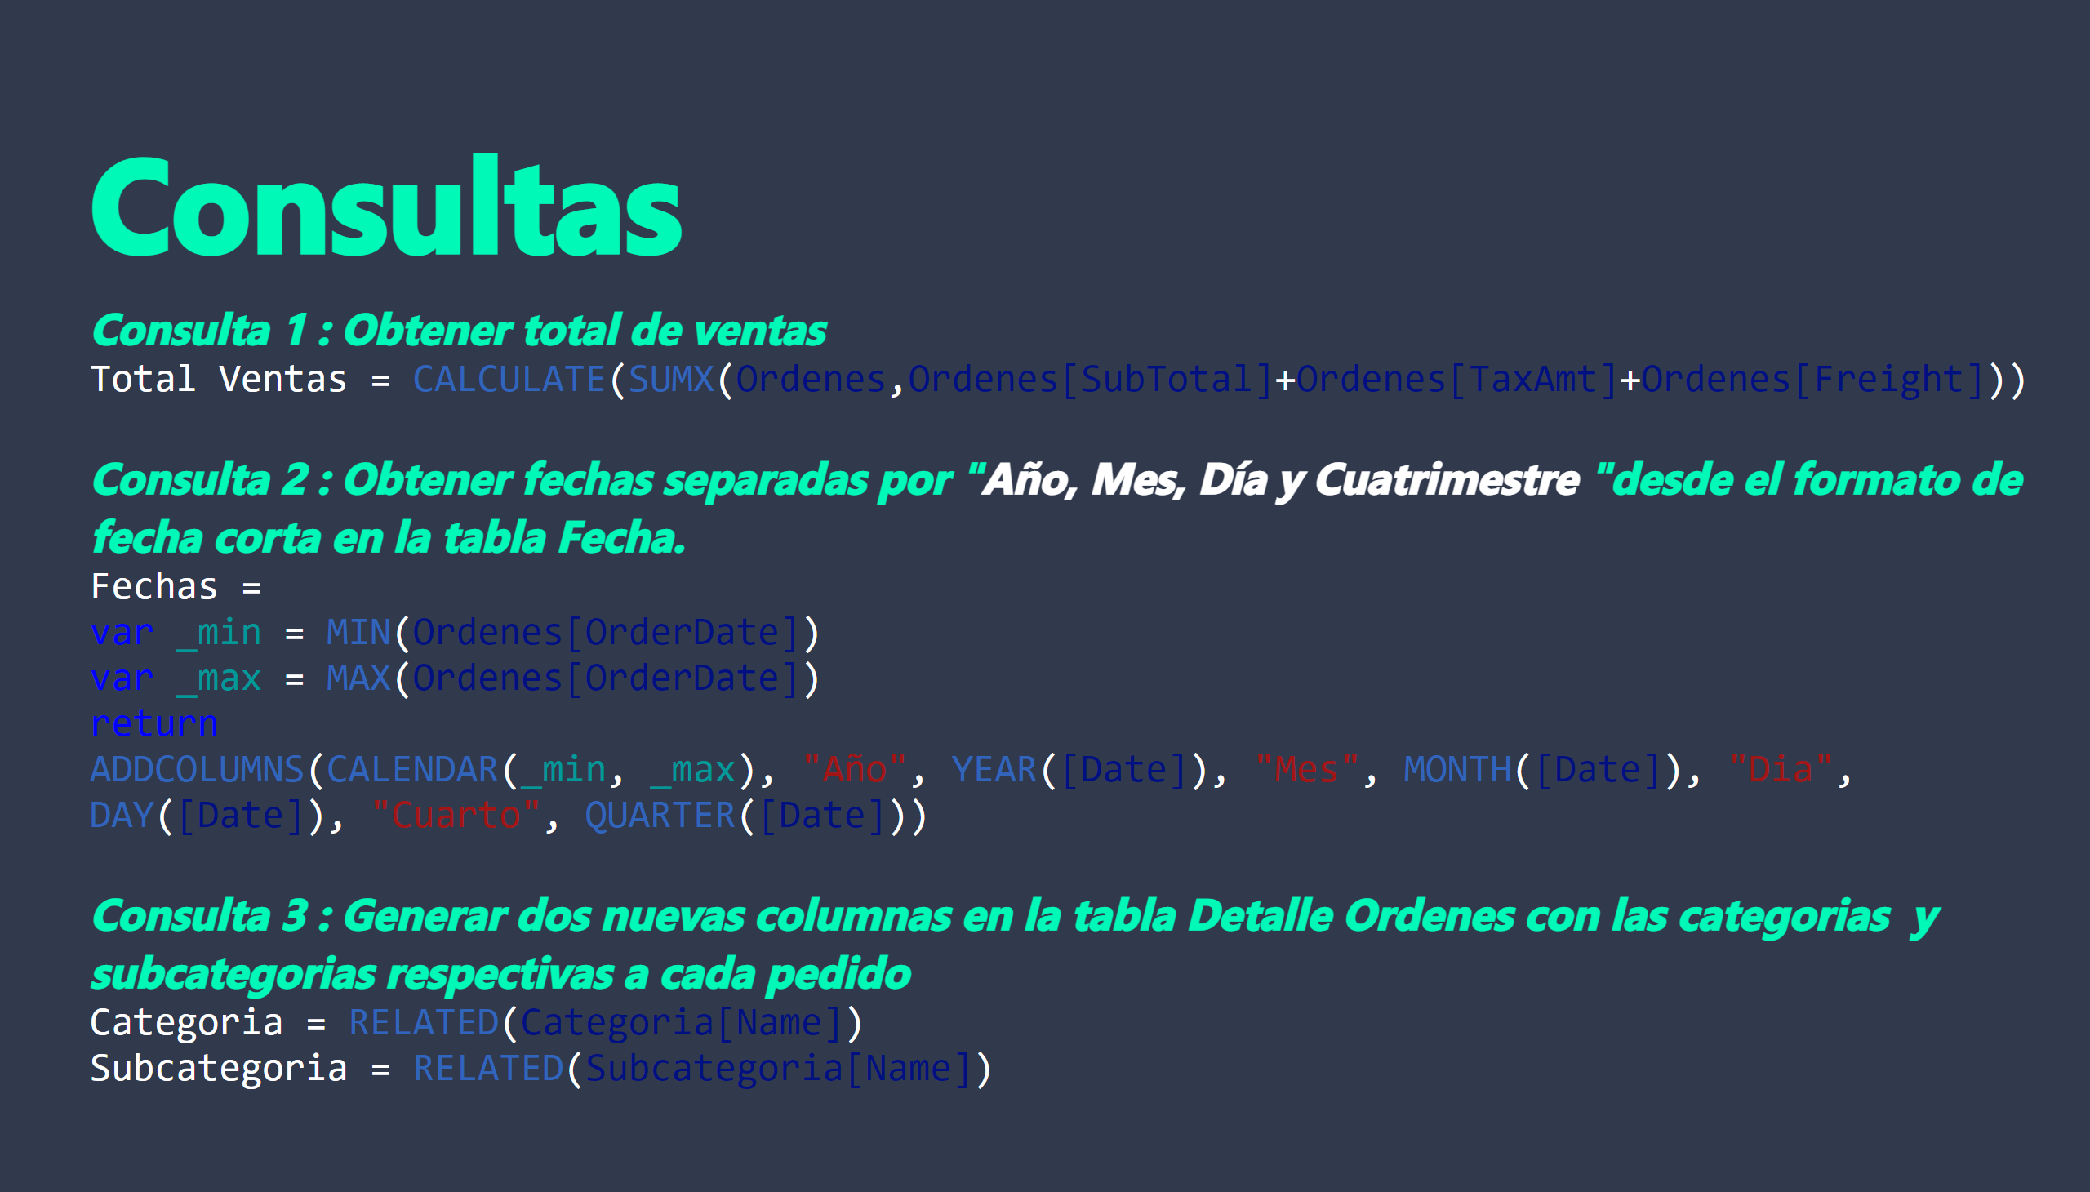
Consultas
Notes:
textbox
No alt text provided
textbox
No alt text provided

Slide 7
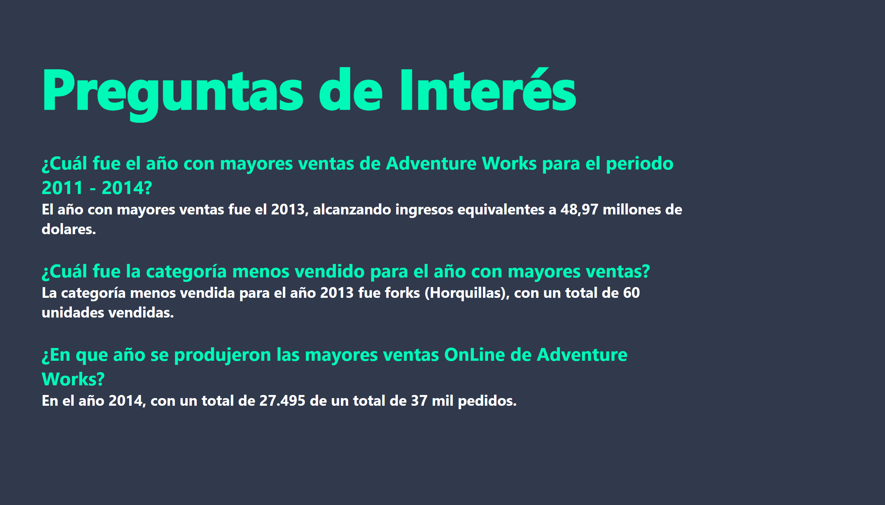
Preguntas
Notes:
textbox
No alt text provided
textbox
No alt text provided

Slide 8
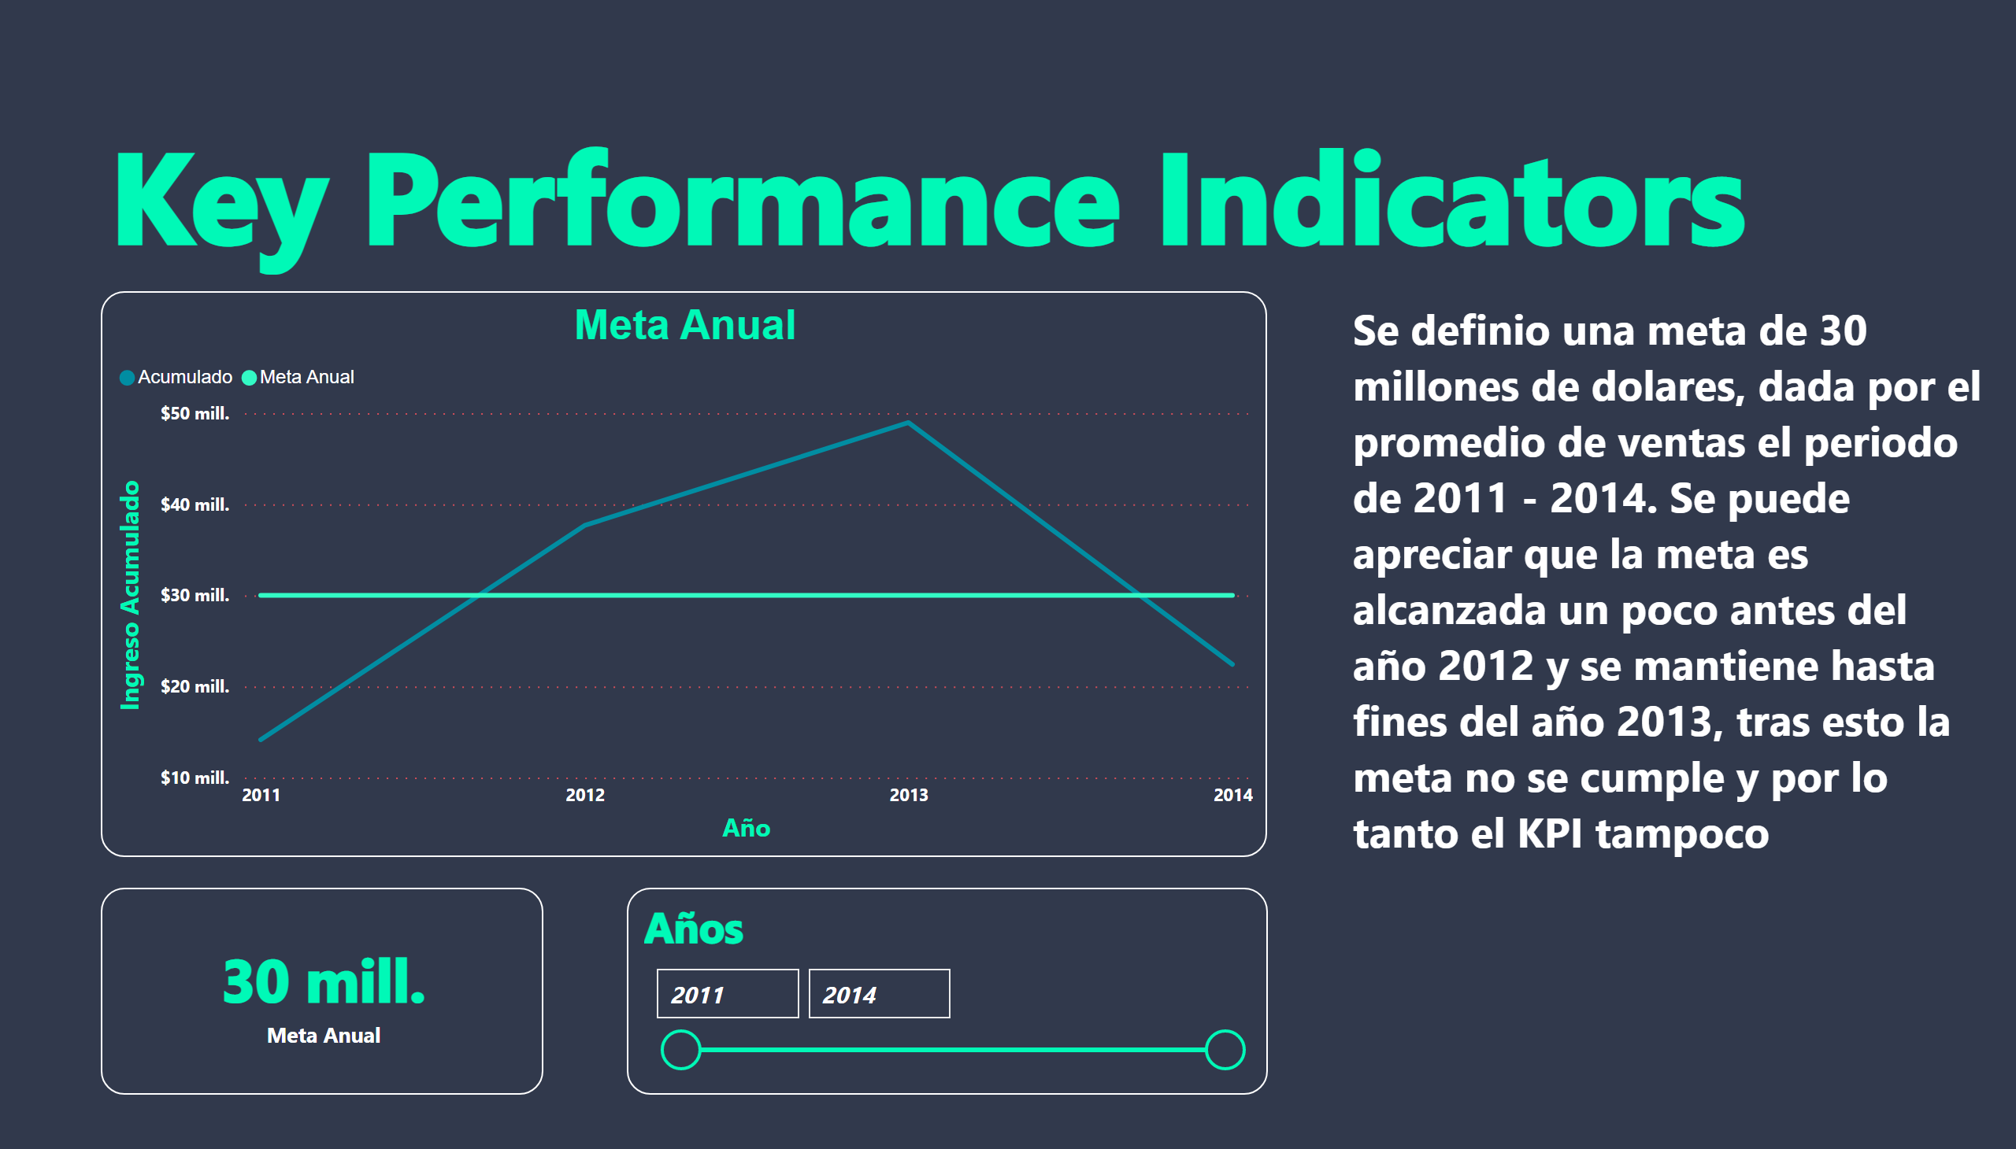
KPI
Notes:
textbox
No alt text provided
Años
No alt text provided
Meta Anual
No alt text provided
card
No alt text provided
textbox
No alt text provided

Slide 9
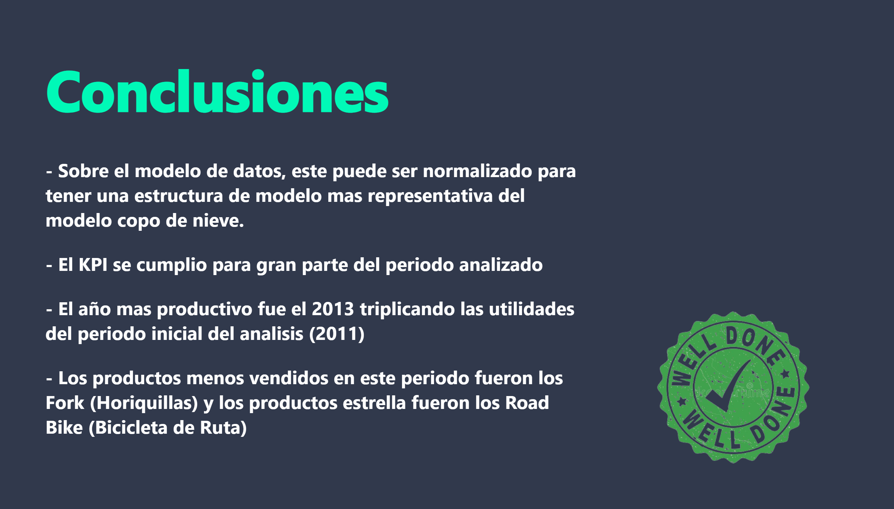
Conclusiones
Notes:
textbox
No alt text provided
textbox
No alt text provided
image
No alt text provided

